Slide 1
AZ-104T00A Administer Virtual Networking

Slide 2
Administer Virtual Networking Introduction
Configure Virtual Networks
Configure Network Security Groups
Configure Azure Firewall
Configure Azure DNS
Lab 04 – Implement Virtual Networks
Notes:
Module overview

Slide 3
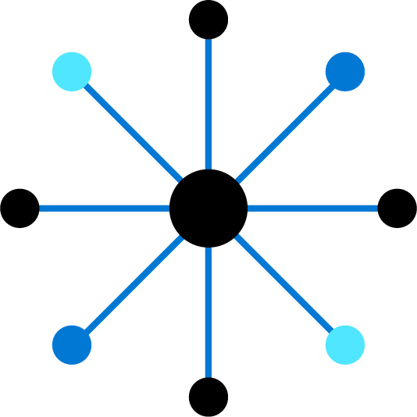
Configure Virtual Networks

Slide 4
Configure Virtual Networks Introduction
Plan Virtual Networks
Create Subnets
Create Virtual Networks
Plan IP Addressing
Create Public IP Addresses
Associate Public IP Addresses
Associate Private IP Addresses
Demonstration – Virtual Networks
Summary and Resources
Notes:
Configure and manage virtual networking (25-30%)
Implement and manage virtual networking
Create and configure virtual networks.
Implement subnets.
Configure private and public IP addresses.

Slide 5
Why do we need Azure Virtual Networks?
Create a dedicated private cloud-only VNet. Sometimes you don't require a cross-premises configuration for your solution. When you create a VNet, your services and VMs within your VNet can communicate directly and securely with each other in the cloud. You can still configure endpoint connections for the VMs and services that require internet communication, as part of your solution.
Securely extend your data center With VNets. You can build traditional site-to-site (S2S) VPNs to securely scale your datacenter capacity. S2S VPNs use IPSEC to provide a secure connection between your corporate VPN gateway and Azure.
Enable hybrid cloud scenarios. VNets give you the flexibility to support a range of hybrid cloud scenarios. You can securely connect cloud-based applications to any type of on-premises system such as mainframes and Unix systems.
Notes:
Does everyone know what RFC1918 addresses are?

Slide 6
Plan Virtual Networks
Virtual Network
Subnet
On-premises
NIC
NIC
Virtual Network(s)
Virtual Machines
Logical representation of your own network
Create a dedicated private cloud-only virtual network
Securely extend your datacenter with virtual networks
Enable hybrid cloud scenarios
Notes:
Azure Virtual Networks - https://azure.microsoft.com/services/virtual-network/
What is Azure Virtual Network? - https://docs.microsoft.com/azure/virtual-network/virtual-networks-overview

Slide 7
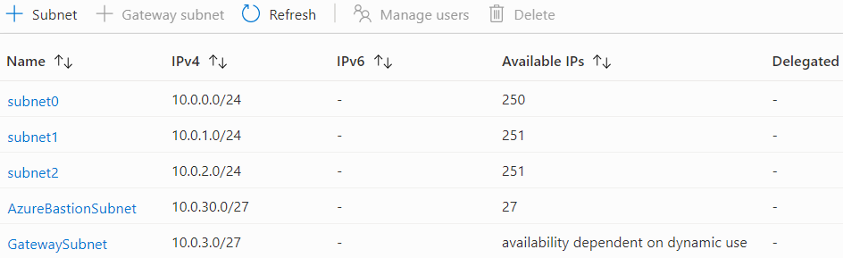
Create Subnets
A virtual network can be segmented into one or more subnets
Subnets provide logical divisions within your network
Subnets can help improve security, increase performance, and make it easier to manage the network
Each subnet must have a unique address range – cannot overlap with other subnets in the vnet in the subscription
Notes:
✔️ Azure reserves 5 IP addresses within each subnet.
x.x.x.0: Network address
x.x.x.1: Reserved by Azure for the default gateway
x.x.x.2, x.x.x.3: Reserved by Azure to map the Azure DNS IPs to the VNet space
x.x.x.255: Network broadcast address

Slide 8
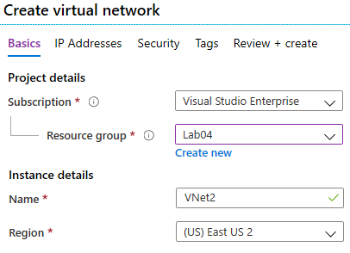
Create Virtual Networks
Create new virtual networks at any time
Add virtual networks when you create a virtual machine
Need to define the address space, and at least one subnet
Be careful with overlapping address spaces
Notes:
QuickStart: Create a virtual network using the Azure portal - https://docs.microsoft.com/azure/virtual-network/quick-create-portal
✔️ Always plan to use an address space that is not already in use in your organization, either on-premises or in other VNets. Even if you plan for a VNet to be cloud-only, you may want to make a VPN connection to it later. If there is any overlap in address spaces at that point, you will have to reconfigure or recreate the VNet. The next lesson will focus on IP addressing.

Slide 9
Plan IP Addressing
Azure
Resource
Internet, public-facing services
VNets, on-premises networks, VPN gateways, ExpressRoute
Private IP address
Public IP address
Private IP addresses - used within an Azure virtual network (VNet), and your on-premises network, when you use a VPN gateway or ExpressRoute circuit to extend your network to Azure
Public IP addresses - used for communication with the Internet, including Azure public-facing services
Notes:
Design an IP addressing schema for your Azure deployment – https://docs.microsoft.com/learn/modules/design-ip-addressing-for-azure
✔️ As a best practice you may decide to separate dynamically and statically assigned IP resources into different subnets. And, IP Addresses are never managed from within a virtual machine.

Slide 10
Design Consideration for Azure Virtual Network Space
Service requirements. Each service directly deployed into virtual network has specific requirements for routing and the types of traffic that must be allowed into and out of subnets. A service may require, or create, their own subnet, so there must be enough unallocated space for them to do so.
Virtual appliances. Azure routes network traffic between all subnets in a virtual network, by default. You can override Azure's default routing to prevent Azure routing between subnets, or to route traffic between subnets through a network virtual appliance.
Service endpoints. You can limit access to Azure resources such as an Azure storage account or Azure SQL database, to specific subnets with a virtual network service endpoint. Further, you can deny access to the resources from the internet.
Network security groups. You can associate zero or one network security group to each subnet in a virtual network. You can associate the same, or a different, network security group to each subnet.
Private Links. Azure Private Link provides private connectivity from a virtual network to Azure platform as a service (PaaS), customer-owned, or Microsoft partner services. It simplifies the network architecture and secures the connection between endpoints in Azure by eliminating data exposure to the public internet.

Slide 11
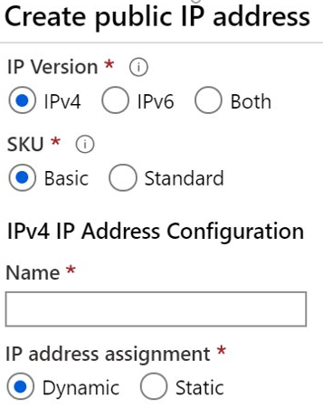
Create Public IP Addresses
Available in IPv4 or IPv6 or both
Basic vs Standard SKU
Dynamic vs Static
Zone redundant (Standard SKU)
Range of contiguous addresses available as a prefix
Notes:
Create, change, or delete IP addresses - https://docs.microsoft.com/azure/virtual-network/virtual-network-public-ip-address

Slide 12
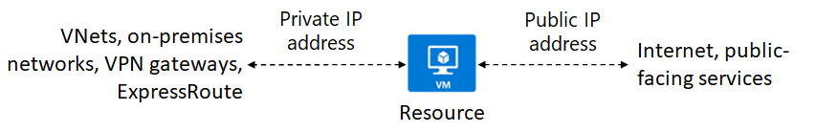
Plan IP Assignment
Notes:
Private IP addresses: For communication within an Azure virtual network (VNet), and your on-premises network, when you use a VPN gateway or ExpressRoute circuit to extend your network to Azure.
Public IP addresses: For communication with the Internet, including Azure public-facing services.
IP Addresses are never managed from within a virtual machine.
Static IP addresses don't change and are best for certain situations such as:
DNS name resolution, where a change in the IP address would require updating host records.
IP address-based security models that require apps or services to have a static IP address.
TLS/SSL certificates linked to an IP address.
Firewall rules that allow or deny traffic using IP address ranges.
Role-based VMs such as Domain Controllers and DNS servers.

Slide 13
Associate Public IP Addresses
Public IP addresses | IP address association | Dynamic | Static
Virtual Machine | NIC | Yes | Yes
Load Balancer | Front-end configuration | Yes | Yes
VPN Gateway | Gateway IP configuration | Yes | Yes*
Application Gateway | Front-end configuration | Yes | Yes*
A public IP address resource can be associated with virtual machine network interfaces, internet-facing load balancers, VPN gateways, and application gateways
*Static IP addresses only available on certain SKUs.
Notes:
Public IP addresses - https://docs.microsoft.com/azure/virtual-network/public-ip-addresses

Slide 14
Associate Private IP Addresses
Private IP Addresses | IP address association | Dynamic | Static
Virtual Machine | NIC | Yes | Yes
Internal Load Balancer | Front-end configuration | Yes | Yes
Application Gateway | Front-end configuration | Yes | Yes
Dynamic (default). Azure assigns the next available unassigned or unreserved IP address in the subnet’s address range
Static. You select and assign any unassigned or unreserved IP address in the subnet's address range
Notes:
Private IP addresses - https://docs.microsoft.com/azure/virtual-network/private-ip-addresses
Dynamic. Dynamic addresses are assigned only after a public IP address is associated to an Azure resource, and the resource is started for the first time. Dynamic addresses can change if they're assigned to a resource, such as a virtual machine, and the virtual machine is stopped (deallocated), and then restarted. The address remains the same if a virtual machine is rebooted or stopped (but not deallocated). Dynamic addresses are released when a public IP address resource is dissociated from a resource.
Static. Static addresses are assigned when a public IP address is created. Static addresses aren't released until a public IP address resource is deleted. If the address isn't associated to a resource, you can change the assignment method after the address is created. If the address is associated to a resource, you may not be able to change the assignment method. If you select IPv6 for the IP version, the assignment method must be Dynamic for Basic SKU. Standard SKU addresses are Static for both IPv4 and IPv6.

Slide 15
Azure Platform IP Addresses
Azure reserves the first four and last IP address for a total of 5 IP addresses within each subnet.
For example, the IP address range of 192.168.1.0/24 has the following reserved addresses:
192.168.1.0: Network address
192.168.1.1: Reserved by Azure for the default gateway
192.168.1.2, 192.168.1.3: Reserved by Azure to map the Azure DNS IPs to the VNet space
192.168.1.255: Network broadcast address.

Slide 16
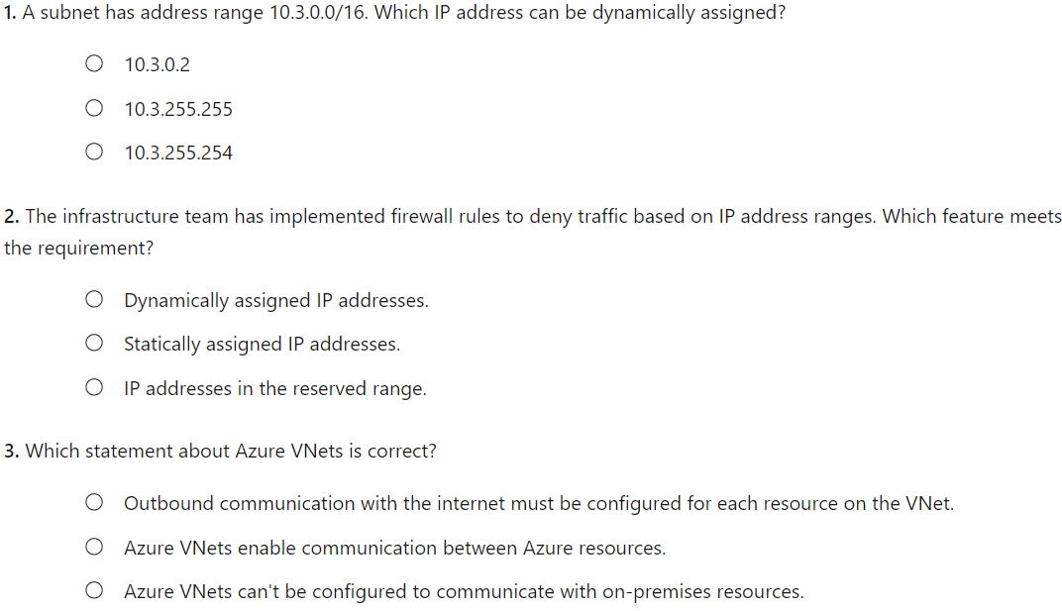
Knowledge Check
Notes:
C
B
B

Slide 17
Summary and Resources – Configure Virtual Networks
Knowledge Check
Microsoft Learn Modules (docs.microsoft.com/Learn)
Design an IP addressing schema for your Azure deployment (Sandbox)
Implement Windows Server IaaS VM IP addressing and routing
A sandbox indicates a hands-on exercise.
Notes:
Learn - https://docs.microsoft.com/learn/browse/
The Assessment Guide in the MCT DLC has open-ended questions.
What is a virtual network and what things should you consider when creating a virtual network?
Answer: A virtual network is a logical representation of your own network. Virtual networks can be used in cloud and hybrid cloud scenarios. When creating a virtual network, you will need to define the address space and create at least one subnet. Subnets in the virtual network subnet must have a unique address range that does not overlap with other subnets. Also consider traffic control, resource isolation, and topology.
What are the two types of virtual networking addresses and how are the addresses used?
Answer: Private IP addresses used within an Azure virtual network, and your on-premises network. When you use a VPN gateway or ExpressRoute circuit to extend your network to Azure, you are using private IP addresses. Public IP addresses are used for communication with the internet, including Azure public-facing services. For example, a customer retail website.

Slide 18
Configure Network Security Groups

Slide 19



Configure Network Security Groups Introduction
Implement Network Security Groups (NSGs)
Determine NSG Rules
Determine NSG Effective Rules
Create NSG Rules
Implement Application Security Groups (ASGs)
Demonstration – NSGs
Summary and Resources
Notes:
Configure and manage virtual networking (25-30%)
Secure access to virtual networks
Create security rules
Associate an NSG to a subnet or network interface
Evaluate effective security rules

Slide 20
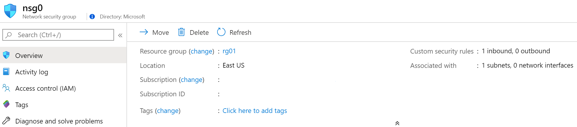
Implement Network Security Groups (NSGs)
Limits network traffic to resources in a virtual network
Lists the security rules that allow or deny inbound or outbound network traffic
Associated to a subnet or a network interface
Can be associated multiple times
Notes:
Network Security Groups - https://docs.microsoft.com/azure/virtual-network/security-overview#network-security-groups
✔️ To simplify management of security rules, it's recommended that you associate a network security group to individual subnets, rather than individual network interfaces within the subnet.
Subnets
You can assign Network Security Groups to subnets and create protected screened subnets (also called a DMZ). These NSGs can restrict traffic flow to all the machines that reside within that subnet. Each subnet can have zero, or one, associated network security groups.
Network interfaces
You can assign NSGs to a NIC so that all the traffic that flows through that NIC is controlled by NSG rules. Each network interface that exists in a subnet can have zero, or one, associated network security groups.
It is possible to assign NSGs to both but it is not recommended.

Slide 21
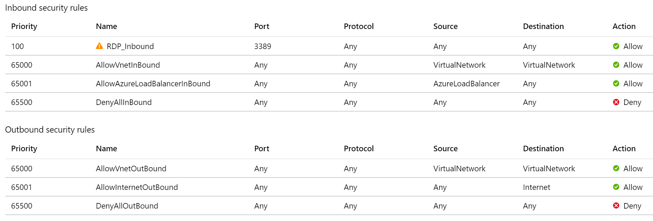
Determine NSG Rules
Security rules in NSGs enable you to filter network traffic that can flow in and out of virtual network subnets and network interfaces
There are default security rules. You cannot delete the default rules, but you can add other rules with a higher priority
Notes:
Create, change, or delete a network security group -https://docs.microsoft.com/azure/virtual-network/manage-network-security-group
Security rules in network security groups enable you to filter the type of network traffic that can flow in and out of virtual network subnets and network interfaces. Azure creates several default security rules within each network security group.
Top 65000-65500 - There are three default inbound security rules. The rules deny all inbound traffic except from the virtual network and Azure load balancers.
Bottom 65000-65500 - There are three default outbound security rules. The rules only allow outbound traffic to the Internet and the virtual network.
You can add more rules by specifying:
Name
Priority
Port
Protocol (Any, TCP, UDP)
Source (Any, IP Addresses, Service tag)
Destination (Any, IP Addresses, Virtual Network)
Action (Allow or Deny)
Azure creates the default rules in each network security group that you create. You cannot remove the default rules, but you can override them by creating rules with higher priorities.

Slide 22
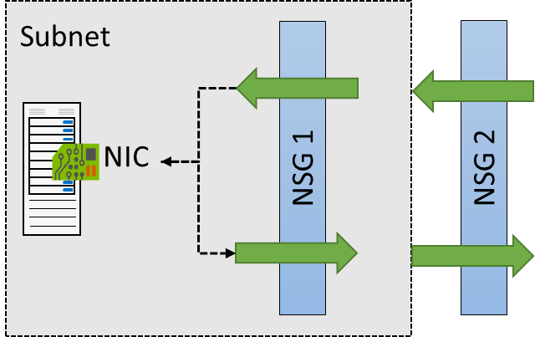
Determine NSG Effective Rules
NSGs are evaluated independently for the subnet and NIC
An “allow” rule must exist at both levels for traffic to be admitted
Use the Effective Rules link if you are not sure which security rules are being applied
Notes:
NSGs are evaluated independently, and an “allow” rule must exist at both levels otherwise traffic won't be allowed.

Slide 23
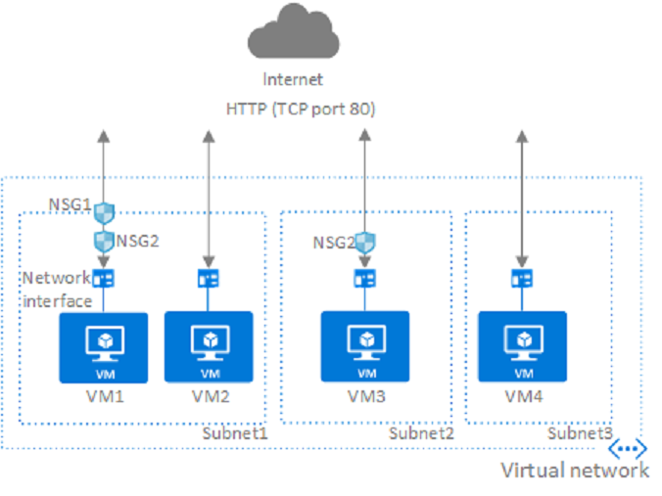
Digging Deeper on Rule Assignment
Notes:
NSGs are evaluated independently, and an “allow” rule must exist at both levels otherwise traffic won't be allowed.
Look at the NSG assign at both levels.
In the above example, if there was incoming traffic on port 80, you would need to have the NSG at the subnet level ALLOW port 80. You would also need another NSG with an ALLOW rule on port 80 at the NIC level.
For incoming traffic, the NSG set at the subnet level is evaluated first, then the NSG set at the NIC level is evaluated. For outgoing traffic, it's the reverse.
If you have several NSGs and aren't sure which security rules are being applied, you can use the Effective security rules link. For example, you could verify the security rules being applied to a network interface.

Slide 24
Create NSG rules
Source (Any, IP addresses, service tags, application security group)
Destination (Any, IP addresses, virtual network, application security group)
Service (HTTPS, SSH, RDP, DNS, POP3, custom, …)
Priority – The lower the number, the higher the priority
Notes:
Tutorial: Filter network traffic with a network security group using the Azure portal - https://docs.microsoft.com/azure/virtual-network/tutorial-filter-network-traffic
Secure and isolate access to Azure resources by using network security groups and service endpoints - https://docs.microsoft.com/learn/modules/secure-and-isolate-with-nsg-and-service-endpoints/

Slide 25



Implement Application Security Groups
Extends your application's structure
ASGs logically group virtual machines – web servers, application servers
WebServers
AppLServers
Define rules to control the traffic flow
Wrap the ASG with an NSG for added security
Source | Destination | Port
Internet | WebServers | 80, 443
WebServers | SQLServers | 1533
Notes:
Application Security Groups (ASGs) ) logically group virtual machines by workload and define network security rules based on those groups. ASGs work in the same way as NSGs but provide an application-centric way of looking at your infrastructure. You join virtual machines to the ASG, and then use the ASG as a source or destination in NSG rules.
Shoppers access the company’s product catalog hosted on Web Servers. The Web Servers must be accessible from the internet over HTTP port 80 and HTTPS port 443.
Inventory information is located on Database Servers. The Database Servers must be accessible over port 1433. Only the Web Servers should have access to the Database Servers.

Slide 26
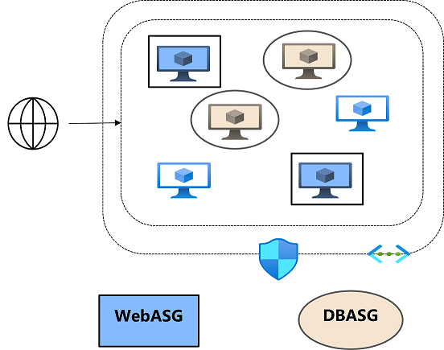
Application Security Groups Scenario
Priority: 100, allow access from the internet to WebASG with port 80 and 443.
Priority: 110, allow access from WebASG to DBASG with port 1433.
Priority: 120, deny access from anywhere to DBASG with port 1433.
Notes:
Create an ASG (WebASG) that groups the Web Servers. Create another ASG (DBASG) that groups the Database Servers. Assign the corresponding server NICs to each ASG.

Slide 27
Benefits of Using Application Security Groups
The configuration doesn’t require specific IP addresses. It would be difficult to specify IP addresses because of the number of servers and because the IP addresses could change. You also don't need to arrange the servers into a specific subnet.
This configuration doesn't require multiple rule sets. You don't need to create a separate rule for each VM. You can dynamically apply new rules to ASG. New security rules are automatically applied to all the VMs in the Application Security Group.
The configuration is easy to maintain and understand since is based on workload usage.

Slide 28
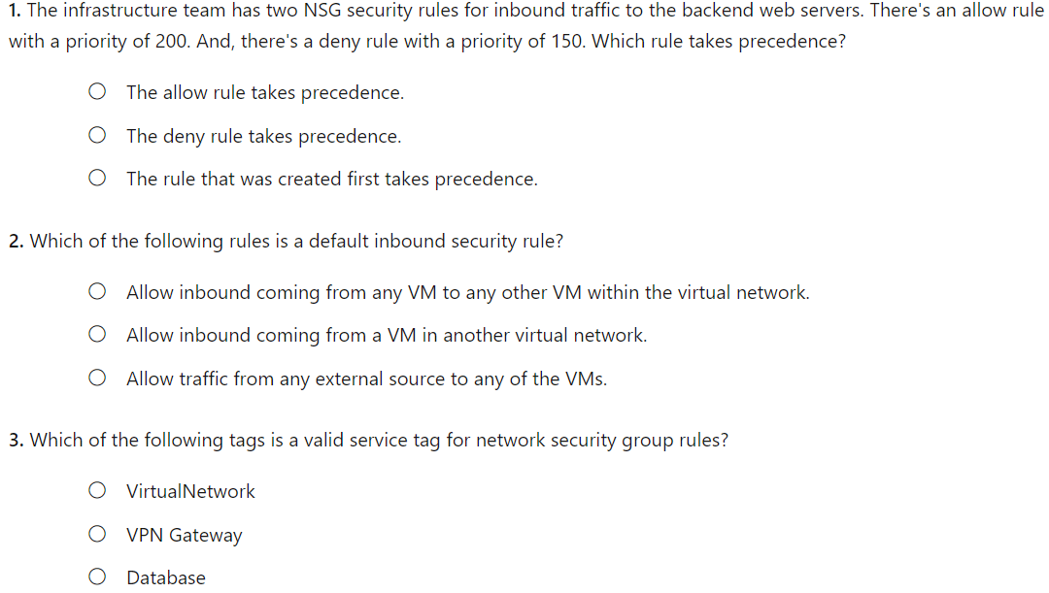
Knowledge Check
Notes:
B
A
A

Slide 29
Demonstration – Network Security Groups
Access the NSGs blade
Add a new NSG
Explore inbound and outbound rules
Notes:
✔ Always consider having students walk-through the demonstrations themselves. Also, consider the overlap with the formal labs and your best use of time.

Slide 30
Summary and Resources – Configure Network Security Groups
Knowledge Check
Microsoft Learn Modules (docs.microsoft.com/Learn)
Secure and isolate access to Azure resources by using network security groups and service endpoints (Sandbox)
A sandbox indicates a hands-on exercise.
Notes:
Learn - https://docs.microsoft.com/learn/browse/
The Assessment Guide in the MCT DLC has open-ended questions.
What is a Network Security Group (NSG) and when would you use it?
Answer: A NSG filters network traffic to and from Azure resources in an Azure virtual network. An NSG lists the security rules that allow or deny inbound or outbound network traffic. For example, limiting inbound traffic to only frontend web servers. Another example, limiting outbound traffic from protect internal virtual machines.
What is an Application Security Group (ASG) and when would you use it?
Answer: An ASG is a logical grouping of virtual machines. For example, you could group web servers and SQL database application servers. To control the traffic flow security rules can then be assigned to each ASG. By placing a NSG around the ASGs you can further control inbound and outbound access.

Slide 31
Lesson 03: Configure Azure Firewall

Slide 32
Configure Azure Firewall Introduction
Determine Azure Firewall Uses
Create Azure Firewalls
Create Azure Firewall Rules
Summary and Resources
Notes:
Configure and manage virtual networking (25-30%)
Secure access to virtual networks
Implement Azure Firewall

Slide 33
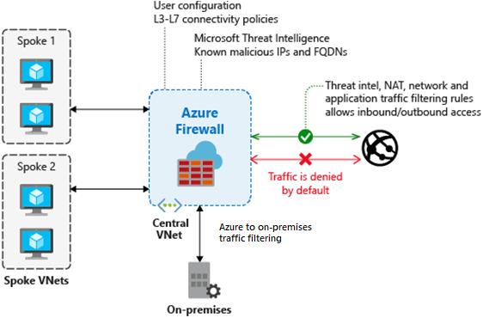
Determine Azure Firewall Uses
Stateful firewall as a service
Built-in high availability with unrestricted cloud scalability
Create, enforce, and log application and network connectivity policies
Threat intelligence-based filtering
Fully integrated with Azure Monitor for logging and analytics
Support for hybrid connectivity through deployment behind VPN and ExpressRoute Gateways
Notes:
Azure Firewall documentation - https://docs.microsoft.com/azure/firewall/
Ask someone to answer what a stateful firewall is
Availability Zones. Azure Firewall can be configured during deployment to span multiple Availability Zones for increased availability.
Threat intelligence. Threat intelligence-based filtering can be enabled for your firewall to alert and deny traffic from/to known malicious IP addresses and domains. The IP addresses and domains are sourced from the Microsoft Threat Intelligence feed.
Multiple public IP addresses. You can associate multiple public IP addresses with your firewall.

Slide 34
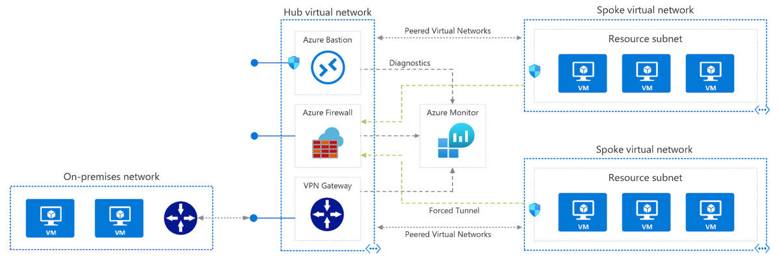
What is a Hub and Spoke Architecture?
Notes:
Cost savings by centralizing services that can be shared by multiple workloads, such as network virtual appliances (NVAs) and DNS servers, in a single location.
Overcome subscriptions limits by peering virtual networks from different subscriptions to the central hub.
Separation of concerns between central IT (SecOps, InfraOps) and workloads (DevOps).

Slide 35
Benefits of the Hub and Spoke model?
The hub is a virtual network in Azure that acts as a central point of connectivity to your on-premises network.
The spokes are virtual networks that peer with the hub, and can be used to isolate workloads.
Traffic flows between the on-premises datacentre and the hub through an ExpressRoute or VPN gateway connection.
Workloads in different environments that require shared services. For example, development and testing environments that require DNS. Shared services are placed in the hub virtual network. Each environment is deployed to a spoke to maintain isolation.
Workloads that don't require connectivity to each other, but require access to shared services.
Enterprises that require central control over security aspects. For example, a firewall in the hub and workloads in each spoke.

Slide 36

Create Azure Firewalls
A Hub-Spoke network topology is recommended
Shared services are placed in the hub virtual network
Each environment is deployed to a spoke to maintain isolation
Notes:
Hub-spoke network topology in Azure - https://docs.microsoft.com/azure/architecture/reference-architectures/hybrid-networking/hub-spoke

Slide 37
Create Azure Firewall Rules
Azure Firewall Manager centralizes firewall management
Firewall policies container rules and settings to control access
NAT rules allow incoming connections
Network rules contain source and destination addresses, protocols, and destination ports
Application rules provide qualified domain names (FQDNs) that can be accessed from a subnet
Notes:
Tutorial: Deploy and configure Azure Firewall and policy using the Azure portal - https://docs.microsoft.com/azure/firewall/tutorial-firewall-deploy-portal-policy

Slide 38
Configuring Rules on Azure Firewall
NAT rules
You can configure Azure Firewall Destination Network Address Translation (DNAT) to translate and filter inbound traffic to your subnets. Each rule in the NAT rule collection is used to translate your firewall public IP and port to a private IP and port. Scenarios where NAT rules might be helpful are publishing SSH, RDP, or non-HTTP/S applications to the Internet.
Network rules
Any non-HTTP/S traffic that will be allowed to flow through the firewall must have a network rule. For example, if resources in one subnet must communicate with resources in another subnet, then you would configure a network rule from the source to the destination.
Application rules define fully qualified domain names (FQDNs) that can be accessed from a subnet. For example, specify the Windows Update network traffic through the firewall.
Application rules
Notes:
When a packet is being inspected to determine if it is allowed or not, the rules are processed in this order:
Network Rules
Application Rules (network and application)
Once a rule is found that allows the traffic through, no more rules are checked.

Slide 39
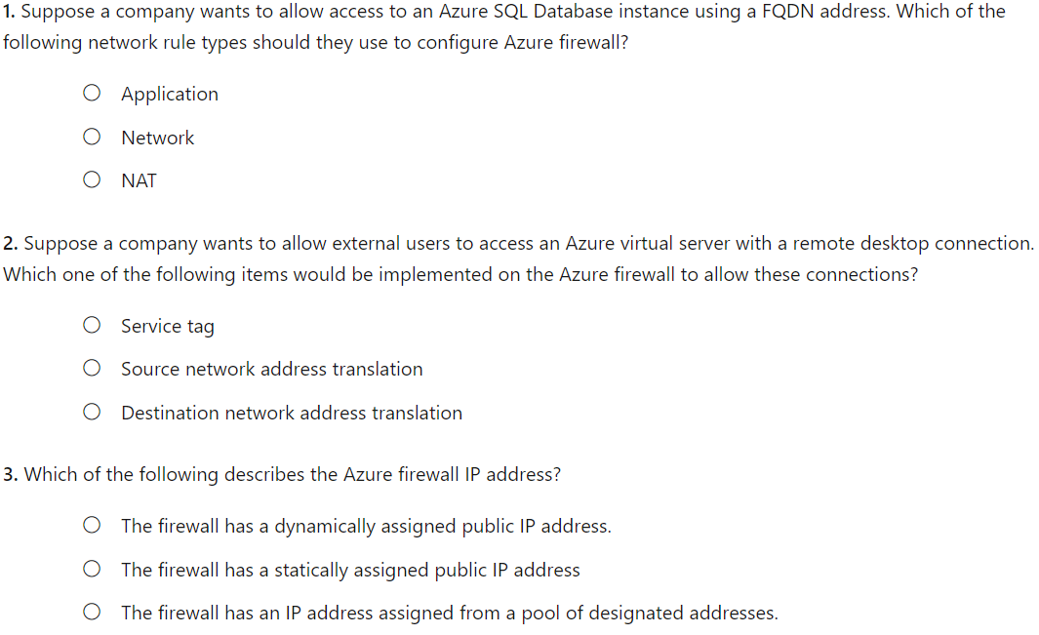
Knowledge Check
Notes:
A
C
B

Slide 40
Summary and Resources - Azure Firewall
Knowledge Check
Microsoft Learn Modules (docs.microsoft.com/Learn)
Introduction to Azure Firewall
Introduction to Azure Firewall Manager
Notes:
Learn - https://docs.microsoft.com/learn/browse/
The Assessment Guide in the MCT DLC has open-ended questions.
What is an Azure Firewall and how would you use it?
Answer: Azure Firewall is a managed, cloud-based network security service that protects your Azure virtual network resources. Firewalls are usually deployed in a hub-spoke topology. Shared services (i.e., Bastion, VPN Gateways) are in the hub. Internal services are isolated and protected in the spokes. Azure Firewall can be used to translate and filter inbound internet traffic to your subnets. Azure Firewall can also be used to connect your on-premises network to Azure. You can configure rules (source addresses, protocols, destination ports, and destination addresses) to specific exactly what the firewall filters.

Slide 41
Configure Azure DNS

Slide 42
Configure Azure DNS Introduction
Identify Domains and Custom Domains
Verify Custom Domain Names (optional)
Create Azure DNS Zones
Delegate DNS Domains
Add DNS Record Sets
Plan for Private DNS Zones
Determine Private Zone Scenarios
Demonstration – DNS Name Resolution
Summary and Resources
Notes:
Configure and manage virtual networking (25-30%)
Implement and manage virtual networking
* Configure Azure DNS, including custom DNS settings and private or public DNS zones.

Slide 43
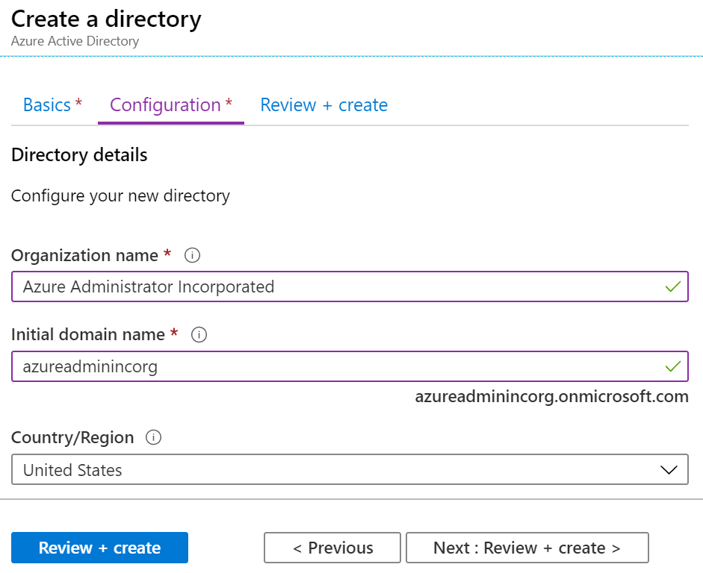
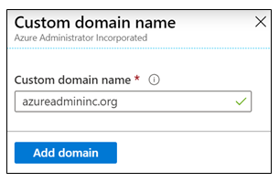
Identity Domains and Custom Domains
When you create an Azure subscription an Azure AD domain is created for you
The domain has initial domain name in the form domainname.onmicrosoft.com
You can’t customize/change the name
After the custom name is added it must be verified – this demonstrates ownership of the domain
Notes:
What is Azure DNS? - https://docs.microsoft.com/azure/dns/dns-overview

Slide 44
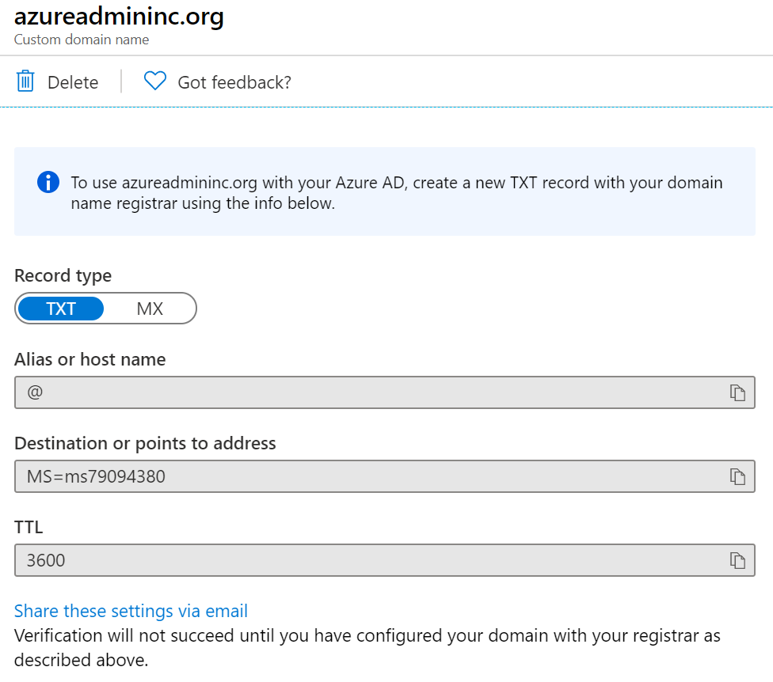
Verify Custom Domain Names
Verification demonstrates ownership of the domain name
Add a DNS record (MX or TXT) that is provided by Azure into your company’s DNS zone
Azure will query the DNS domain for the presence of the record
This could take several minutes or several hours – DNS replication
Notes:
QuickStart: Create an Azure DNS zone and record using the Azure portal - https://docs.microsoft.com/azure/dns/dns-getstarted-portal

Slide 45
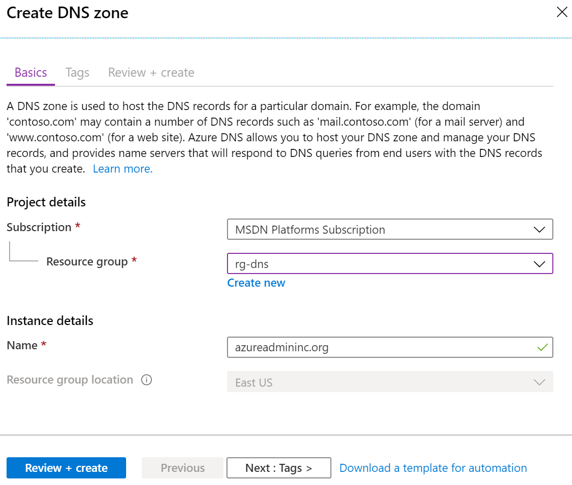
Create Azure DNS Zones
A DNS zone hosts the DNS records for a domain
Where multiple zones share the same name, each instance is assigned different name server addresses
Root/Parent domain is registered at the registrar and pointed to Azure NS
Notes:
This is public DNS zones – there are public DNS zones as well!
A DNS zone hosts the DNS records for a domain. So, to start hosting your domain in Azure DNS, you need to create a DNS zone for that domain name. Each DNS record for your domain is then created inside this DNS zone.

Slide 46
Things to remember with Azure DNS (Public) Zones
The name of the zone must be unique within the resource group, and the zone must not exist already.
The same zone name can be reused in a different resource group or a different Azure subscription.
Where multiple zones share the same name, each instance is assigned different name server addresses.
Root/Parent domain is registered at the registrar and pointed to Azure DNS.
Child domains are registered in AzureDNS directly.

Slide 47
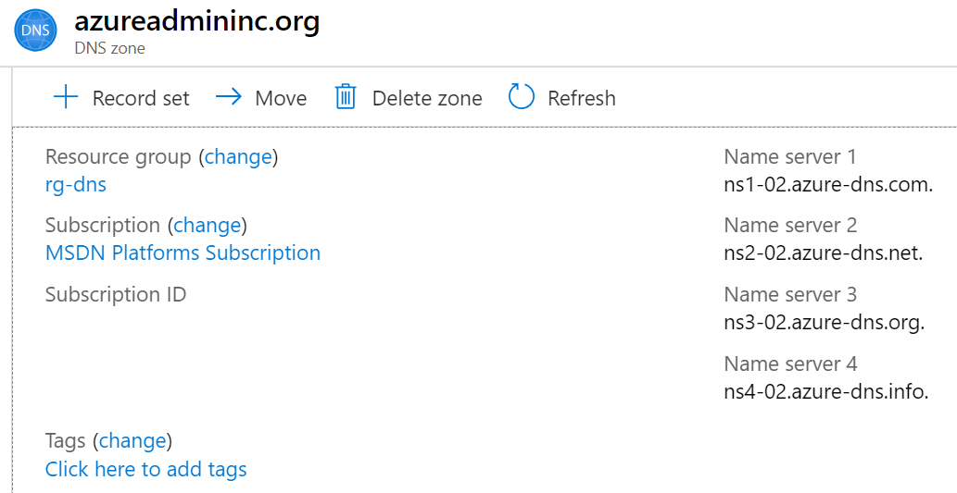
Delegate DNS Domains
When delegating a domain to Azure DNS, you must use the name server names provided by Azure DNS – use all four
Once the DNS zone is created, update the parent registrar
For child zones, register the NS records in the parent domain
Notes:
Host your domain on Azure DNS - https://docs.microsoft.com/learn/modules/host-domain-azure-dns/

Slide 48
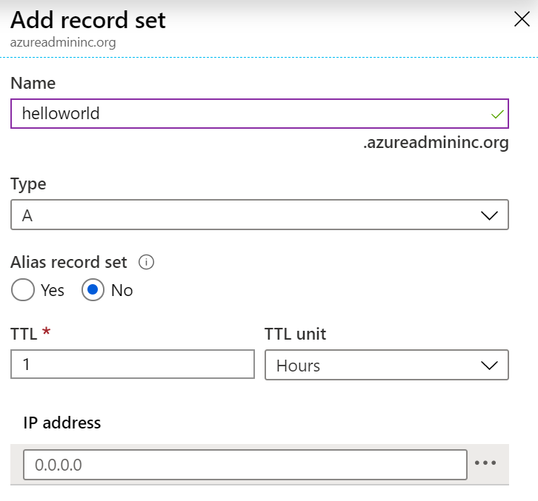
Add DNS Record Sets
A record set is a collection of records in a zone that have the same name and are the same type
You can add up to 20 records to any record set
A record set cannot contain two identical records
Changing the drop-down Type, changes the information required

Slide 49
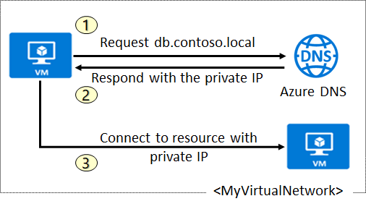
Plan for Private DNS Zones
Use your own custom domain names
Provides name resolution for VMs within a VNet and between VNets
db.contoso.lab
Automatic hostname record management
Removes the need for custom DNS solutions
Use all common DNS records types
Available in all Azure regions
Notes:
QuickStart: Create an Azure private DNS zone using the Azure portal - https://docs.microsoft.com/azure/dns/private-dns-getstarted-portal
It provides name resolution for virtual machines (VMs) within a virtual network and between virtual networks. Additionally, you can configure zones names with a split-horizon view, which allows a private and a public DNS zone to share the name.

Slide 50
Use Cases - Azure Private DNS Zones
Removes the need for custom DNS solutions. Previously, many customers created custom DNS solutions to manage DNS zones in their virtual network. You can now perform DNS zone management by using the native Azure infrastructure.
Use all common DNS records types. Azure DNS supports A, AAAA, CNAME, MX, PTR, SOA, SRV, and TXT records.
Automatic hostname record management. Along with hosting your custom DNS records, Azure automatically maintains hostname records for the VMs in the specified virtual networks. In this scenario, you can optimize the domain names you use without needing to create custom DNS solutions or modify applications.
Hostname resolution between virtual networks. Unlike Azure-provided host names, private DNS zones can be shared between virtual networks. This capability simplifies cross-network and service-discovery scenarios, such as virtual network peering.
Split-horizon DNS support. With Azure DNS, you can create zones with the same name that resolve to different answers from within a virtual network and from the public internet. A typical scenario for split-horizon DNS is to provide a dedicated version of a service for use inside your virtual network.
Notes:
Does anyone know what split-brain DNS is?

Slide 51
Scenario 1: Name resolution scoped to a single virtual network
Query:VM2.contoso.lab
Response:VM1.contoso.lab
DNS resolution in VNet1 is private and not accessible from the Internet
DNS queries across the virtual networks are resolved
Reverse DNS queries are scoped to the same virtual network
Notes:
Scenario 1: Name resolution scoped to a single virtual network
In this scenario, you have a virtual network and resources in Azure, including virtual machines (VMs). You want to resolve the resources from within the virtual network via a specific domain name (DNS zone). You also need the name resolution to be private and not accessible from the internet. Furthermore, for the VMs within the VNET, you need Azure to automatically register them into the DNS zone.
In the above diagram, VNET1 contains two VMs (VM1 and VM2). Each VM has a private IP address. When you create a Private Zone (contoso.lab) and link it to VNet1, Azure DNS will automatically create two A records in the zone if you enable auto registration in the link configuration. DNS queries from VM1 to resolve VM2.contoso.lab will receive a DNS response that contains the Private IP of VM2. And, a Reverse DNS query (PTR) for the Private IP of VM1 (10.0.0.4) issued from VM2 will receive a DNS response that contains the FQDN of VM1, as expected.

Slide 52
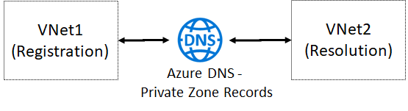
Scenario 2: Name resolution for multiple networks
Notes:
Name resolution across multiple virtual networks is probably the most common usage for DNS private zones. The following diagram shows a simple version of this scenario where there are only two virtual networks - VNet1 and VNet2.
VNet1 is designated as a Registration virtual network and VNET2 is designated as a Resolution virtual network.
The intent is for both virtual networks to share a common zone contoso.lab.
The Resolution and Registration virtual networks are linked to the zone.
DNS records for the Registration VNet VMs are automatically created. You can manually add DNS records for VMs in the Resolution virtual network.

Slide 53
Demonstration - DNS
Create a DNS zone
Add a DNS record set
View your name servers
Test the resolution
Explore DNS metrics
Notes:
✔ Always consider having students walk-through the demonstrations themselves. Also, consider the overlap with the formal labs and your best use of time.

Slide 54
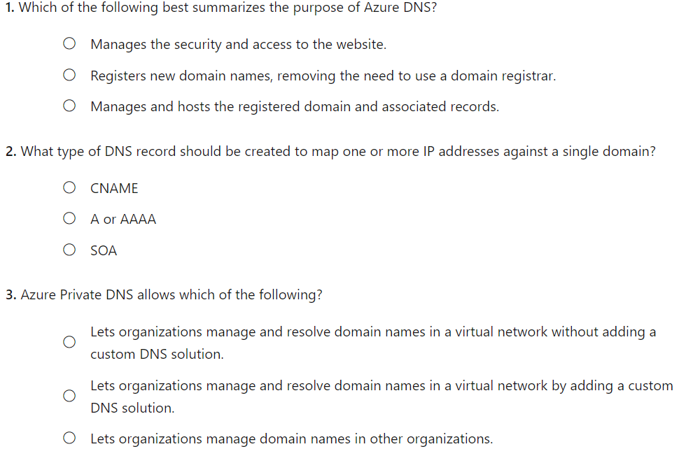
Knowledge Check
Notes:
C
B
A

Slide 55
Summary and Resources – Configure Azure DNS
Knowledge Check
Microsoft Learn Modules (docs.microsoft.com/Learn)
Host your domain on Azure DNS (Sandbox)
Implement DNS for Windows Server IaaS VMs
A sandbox indicates a hands-on exercise.
Notes:
Learn - https://docs.microsoft.com/learn/browse/
The Assessment Guide in the MCT DLC has open-ended questions.
What is an Azure DNS domain, and can you change the name assigned to you?
Answer:. The domain name system (DNS) is a naming database in which internet domain names are located and translated into Internet Protocol (IP) addresses. The domain name system maps the name people use to locate a website to the IP address that a computer uses to locate that website. Azure DNS is a hosting service for DNS domains that provides name resolution. When you create an Azure subscription an Azure AD domain is created for you. This initial domain takes the form domainname.onmicrosoft.com. You can change or customize the domain name. However, you will need to verify ownership of the domain name.

Slide 56
Configure Azure Bastion

Slide 57
Configure Azure Bastion Introduction
Intro to Azure Bastion
Use Cases for Azure Bastion
Azure Bastion Architecture
Decision Criteria for Azure Bastion
Notes:
Configure and manage virtual networking (25-30%)
Implement and manage virtual networking
* Configure Azure DNS, including custom DNS settings and private or public DNS zones.

Slide 58
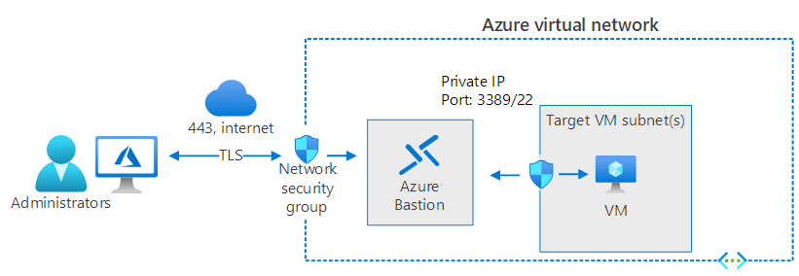
Intro to Azure Bastion
Server administrators understand that it's efficient to remotely administer and maintain servers in an on-premises data center. With Windows infrastructure as a service (IaaS) virtual machines (VMs) being deployed in Azure, administrators must rely solely on remote management to administer and maintain cloud-based resources.

Slide 59
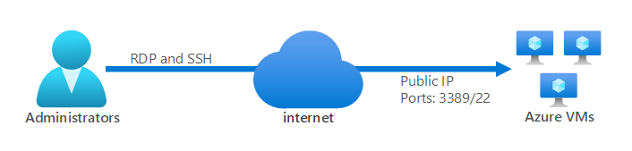
Use Cases for Azure Bastion
Without Azure Bastion if connectivity to Azure VM’s was required, a PIP and open NSG rules would be required on a per VM basis to ensure remote management of they VMs. This would be if a S2S or P2S VPN is not in existence.
Azure Bastion
Removes the need to expose RDP and SSH ports to the internet.
Securely uses both RDP and SSH.

Slide 60
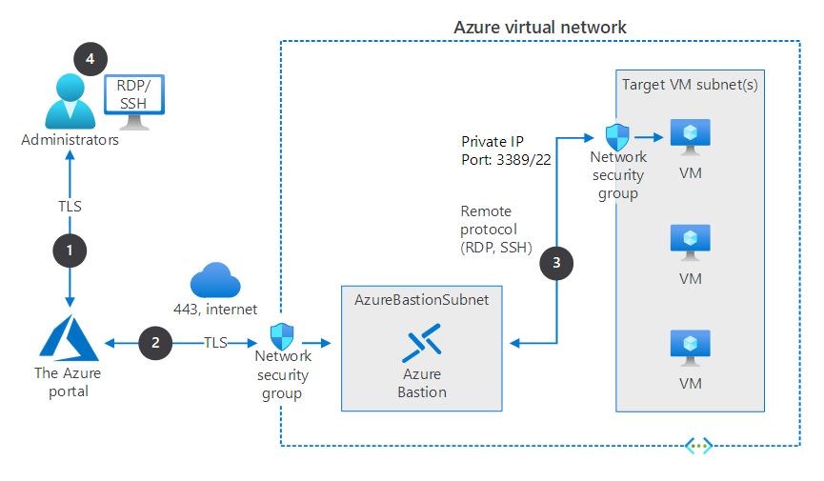
Azure Bastion Architecture
Notes:
Azure Bastion is deployed in a virtual network that contains several Azure VMs.
NSGs protect the subnets in the virtual network.
The NSG protecting the VM subnet allows RDP and SSH traffic from the Azure Bastion subnet.
Azure Bastion supports communications only through TCP port 443 from the Azure portal.
The typical connection process in Azure Bastion is as follows:
An administrator connects to the Azure portal using any HTML5 browser by using a connection secured with TLS. The administrator selects the VM they want to connect to.
The portal connects over a secured connection to Azure Bastion through an NSG that's protecting the virtual network that hosts the targeted VM.
Azure Bastion initiates a connection to the target VM.
The RDP or SSH session opens in the browser on the administrator console. Azure Bastion streams the session information through custom packages. These packages are protected by TLS.

Slide 61
Azure Bastion Networking Requirements
Inbound:
RDP and SSH connections from the Azure Bastion subnet to the target VM subnet
TCP port 443 access from the internet to the Azure Bastion public IP
TCP access from Azure Gateway Manager on ports 443 or 4443
Outbound:
TCP access from the Azure platform on port 443 to support diagnostic logging
The subnet must be called AzureBastionSubnet.

Slide 62
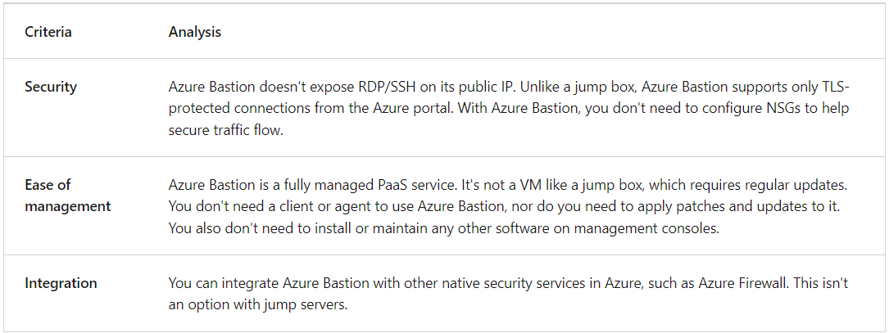
Decision Criteria on Azure Bastion

Slide 63
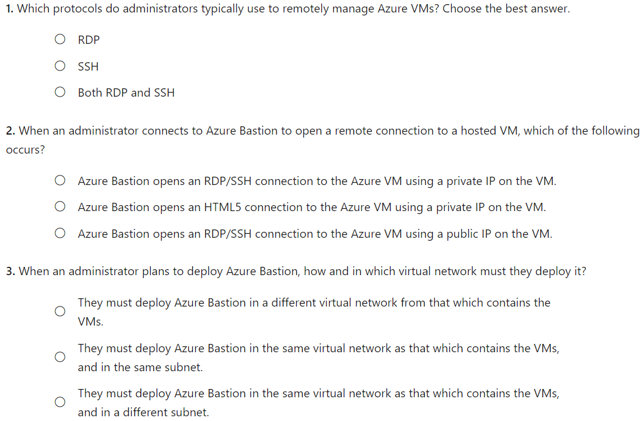
Knowledge Check

Slide 64
Lab 04 – Implement Virtual Networks

Slide 65
Lab 04 – Implement Virtual Networking
Lab scenario
You plan to create a virtual network in Azure that will host a couple of Azure virtual machines. You will deploy them into different subnets of the virtual network. You also want to ensure that their private and public IP addresses will not change over time. To comply with Contoso security requirements, you need to protect public endpoints of Azure virtual machines accessible from Internet. Finally, you need to implement DNS name resolution for Azure virtual machines both within the virtual network and from Internet.
Objectives
Task 1: Create and configure a virtual network
Task 2: Deploy virtual machines into the virtual network
Task 3: Configure private and public IP addresses of Azure VMs
Task 4: Configure network security groups
Task 5: Configure Azure DNS for internal name resolution
Task 6: Configure Azure DNS for external name resolution
Next slide for an architecture diagram
Notes:
LAB 04 - Implement Virtual Networking - ESTIMATED DURATION 40 MIN
Lab Repository - https://microsoftlearning.github.io/AZ-104-MicrosoftAzureAdministrator/

Slide 66






Lab 04 – Architecture diagram
Task 1, Task 2
az104-04-rg1
az104-04-vnet1 10.40.0.0/20
Subnet0 10.40.0.0/24
Subnet1 10.40.1.0/24
Task 5
Private DNS zone
az104-04-vm0
az104-04-vm1
contoso.org
az104-04-nic0
10.40.0.4
az104-04-nic1
10.40.1.4
Task 3
Task 6
az104-04-pip0
az104-04-pip1
DNS zone
Task 4
az104-04-nsg01

Slide 67

End of presentation

Slide 68
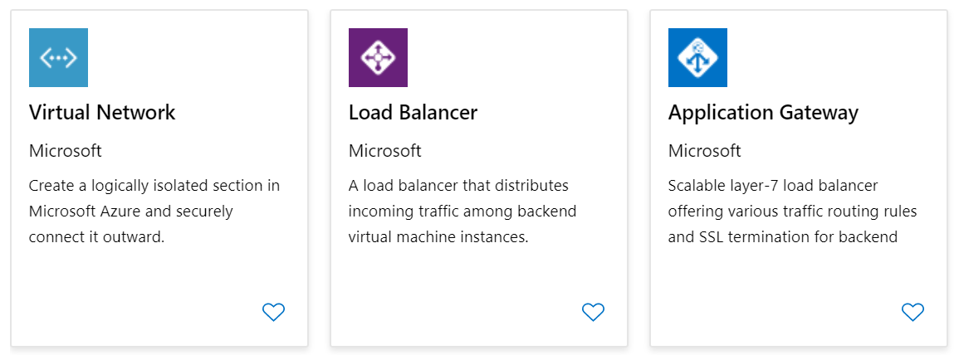
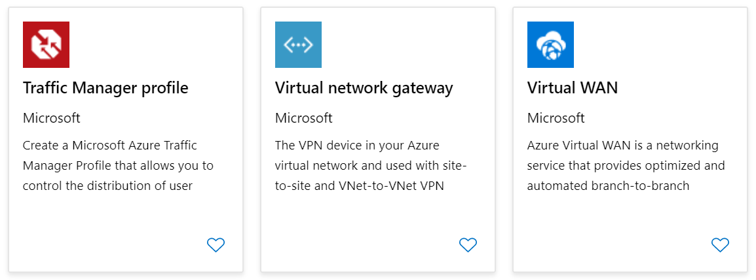
Azure Networking Components (optional)
Adopting cloud solutions can save time and simplify operations
Azure requires the same types of networking functionality as on-premises infrastructure
Azure networking offers a wide range of services and products
Notes:
Extra slide if you like.
Azure networking documentation - https://docs.microsoft.com/azure/networking/

